Slide 1
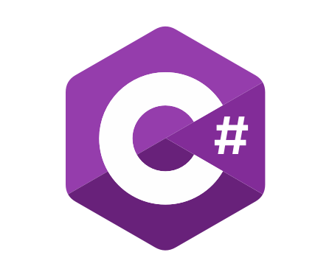
C# Advanced
Course Introduction
SoftUni Team
Technical Trainers
Software University
https://softuni.bg/

Slide 2
Table of Contents
Course Objectives
Training and Team
Course Organization
Course Infrastructure
Evaluation Criteria

Slide 3
Have a Question?
sli.do
#csharp-advanced

Slide 4

Course Objectives

Slide 5
C# Advanced Module Goals
Working with linear data structures
Getting familiar with streams and files
Creating custom data structures
Building class hierarchies
Working with Exceptions
Applying principles and good practices for building quality software
Testing application correctness

Slide 6
C# Advanced Course Goals
Working with linear data structures
Stacks, Queues and Multidimensional Arrays
Getting familiar with streams and files
Creating custom data structures
List, Stack and LinkedList
Simple algorithms
Recursion, Sorting and Searching

Slide 7
Practical Programming Exam
3 practical problems for 4 hours
The first two problems may include:
Stacks and Queues
Multidimensional Arrays
Dictionaries
Defining Classes
Automated judge system
http://judge.softuni.bg
Solutions are evaluated for correctness only
Code quality is still not measured

Slide 8

Exam Demonstration

Slide 9
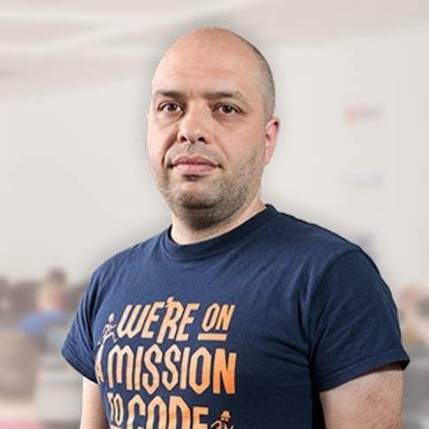

Stamo Petkov
Head Of Department at Information Services Plc.
Worked with various technologies
.NET and C#, BASIC, Pascal, Object Pascal, PHP
More than 15 years of experience
Experienced Lecturer

Slide 10
INFORMATION SERVICES
Key partner of the state institutions in the implementation of ICT projects
The Ministry of Finance
The National Revenue Agency
The Customs Agency
The Ministry of Regional Development and Public Works
The first governmentally approved provider of qualified certification services in Bulgaria
https://www.is-bg.net/bg/

Slide 11
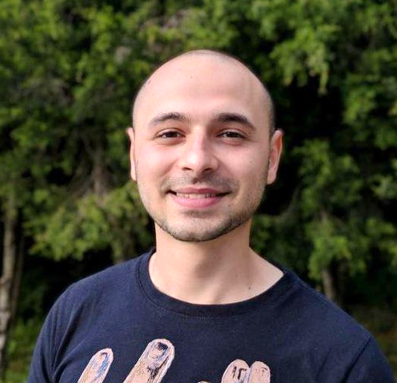
Stoyan Shopov
Team Lead @ SoftUni
Technical Trainer @ SoftUni
ASP.NET Web Developer
Experience with WebForms & WPF
Mountain lover

Slide 12

Course Organization

Slide 13
C# Advanced Module – Timeline
14-May-2019
23-June-2019
28-June-2019
11-August-2019
C# Advanced
6 weeks * 4 times / week
12 credits
Start: 14-May-2019
Final exam: 23-June-2019
Retake exam: 13-August-2019
C# OOP
7 weeks * 4 times / week
15 credits
Start: 28-June-2019
Final exam: 11-August-2019
Retake exam: 15-August-2019

Slide 14

Homework Assignments & Exercises
Your homework is mainly work in class
Lesson days → slides + live demos + exercises
Exercise days → only exercises
How to submit your homework?
Submitted in the judge system
Do your homework when it's due
Assignments pile up quickly

Slide 15


Scoring System for the Course
Mandatory:
Final exam – 95%
Exercises & homework – 5%
Bonuses:
Presence in class – 5% bonus

Slide 16



Course Web Site, Forum and FB Group
Official web site:
Official discussion forum:
Official Facebook group:
https://softuni.bg/courses/csharp-advanced/
https://softuni.bg/forum/categories/30/
https://www.facebook.com/CSharpAdvanced/

Slide 17


The Free C# Fundamentals Textbook
The official textbook for the course
"Fundamentals of Computer Programming with C#", by Svetlin Nakov & Co., 2013, ISBN 9789544007737
English and Bulgarian versions (as PDF, ePub, …)
Freely downloadable from: www.introprogramming.info
The C# Programming courses @SoftUni.bg partially follows the book

Slide 18
https://softuni.bg/courses/csharp-advanced

Slide 19












SoftUni Diamond Partners

Slide 20




SoftUni Organizational Partners

Slide 21




Trainings @ Software University (SoftUni)
Software University – High-Quality Education and Employment Opportunities
softuni.bg
Software University Foundation
http://softuni.foundation/
Software University @ Facebook
facebook.com/SoftwareUniversity
Software University Forums
forum.softuni.bg

Slide 22

License
This course (slides, examples, demos, videos, homework, etc.) is licensed under the "Creative Commons Attribution-NonCommercial-ShareAlike 4.0 International" license

